Slide 1


CMP 656: Advanced Computer and Network Security
Final Project - Hacettepe University
MACHINE LEARNING BASED ANALYSIS FOR DIVERSEVUL DATASET
Refik Can Öztaş
Jan 2024

Slide 2



CONTENT
01
02
03
INTRODUCTION
RELATED WORKS
DIVERSEVUL DATASET AND PAPER
04
05
06
DATASET CHARACTERIZATION
MODELS
DISCUSSION
FUTURE WORK DIRECTION
CONCLUSION

Slide 3

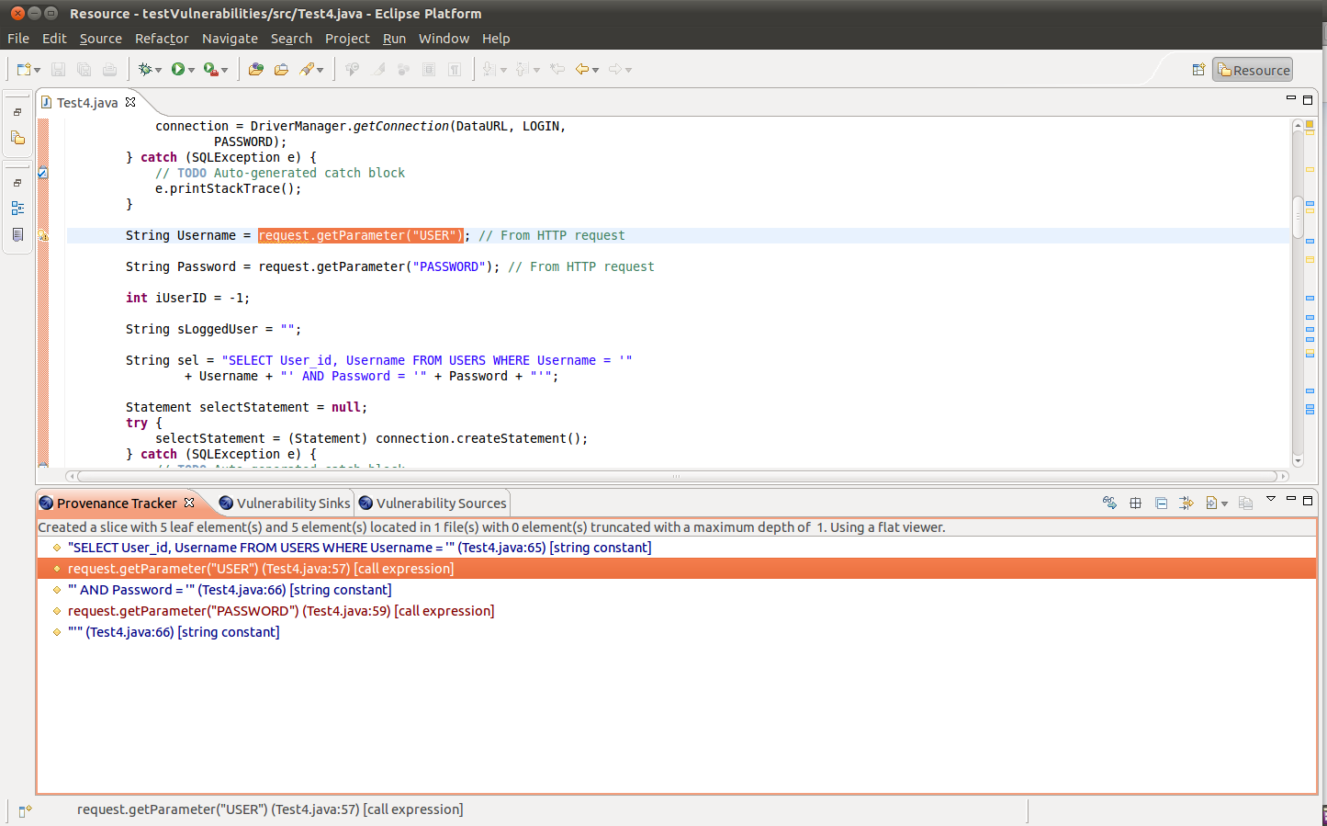


INTRODUCTION
VULNERABILITY IN CODES
STATIC CODE ANALYSIS
SAST
OWASP
NLP BASE SOLUTIONS

Slide 4
DIVERSEVUL
DATASET AND PAPER
In the paper, the researchers present a new vulnerable source code dataset, DiverseVul, for detecting software vulnerabilities using deep learning. The dataset contains 18,945 vulnerable functions spanning 150 CWEs and 330,492 non-vulnerable functions extracted from 7,514 commits. The study evaluates the effectiveness of various deep learning architectures, including Graph Neural Networks (GNN), RoBERTa, GPT-2, and T5, for vulnerability detection. The researchers found that deep learning models require a large dataset of vulnerable source code and identified hopeful future research directions, including the use of large language models (LLMs) and the development of source code-specific pretraining objectives. The paper also addresses the challenges associated with deep learning-based vulnerability detection, such as the need for large training datasets and the generalization failure when detecting vulnerabilities in unseen projects. The researchers highlighted the need for deeper investigation into the impact of label noise in the dataset. Additionally, the study revealed that some common weaknesses and vulnerabilities are more challenging to learn than others, and the generalization performance of deep learning models for detecting vulnerabilities remains a significant challenge. Furthermore, the research also addressed the issue of label noise in the dataset, highlighting the need for further investigation into its impact.

Slide 5
DIVERSEVUL
DATASET AND PAPER
Exploration of Deep Learning for Vulnerability Detection
The paper investigates the potential of deep learning for software vulnerability detection and introduces a new open vulnerability dataset for C/C++, called DiverseVul, which is more than twice the size of previous datasets. The study explores the use of deep learning architectures such as Graph Neural Networks (GNN), RoBERTa, GPT-2, and T5 for vulnerability detection and evaluates their performance on various datasets. It highlights the benefits of increased diversity and volume of training data for vulnerability detection, especially for large language models, while also acknowledging the need for further research on improving deep learning models to generalize to unknown projects.
The paper addresses the challenge of label noise in the dataset and the need for deeper investigation in this area. It also discusses the potential for code-specific pretraining tasks as a promising research direction for deep learning-based vulnerability detection. The authors release the DiverseVul dataset for community use, with the hope that it will enable exploration of methods to address label noise in the future.

Slide 6
DIVERSEVUL
DATASET AND PAPER
Dataset Construction Process and Acknowledgments
Reflecting on the dataset construction process, the paper suggests that the de-duplication procedure could be improved to enhance label accuracy and mitigate risks of contamination such as test data leaking into pretraining data. The authors express gratitude to contributors and reviewers for their valuable input and acknowledge the support of sponsors for the research.
Conclusion and Future Research Recommendations
In conclusion, the paper highlights the potential of deep learning architectures for software vulnerability detection, emphasizes the importance of improving model generalization to unknown projects, and presents the DiverseVul dataset to the community for further exploration and research in vulnerability detection. The study also identifies challenges such as label noise, de-duplication procedures, and risks of contamination, while expressing gratitude to contributors, reviewers, and sponsors for their support.

Slide 7

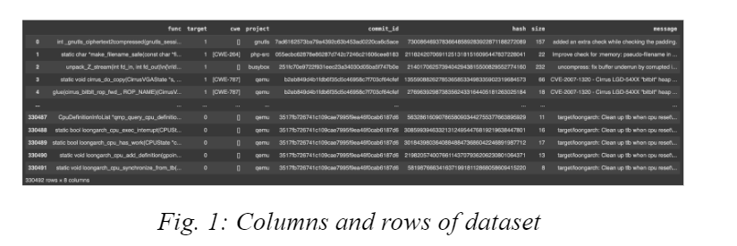
DATASET CHARACTERIZATION
Data
Dataset contains 330492 rows × 8 columns. Columns are: func, target,cwe,project,commit_id,hash,size,message
DIVERSEVUL

Slide 8
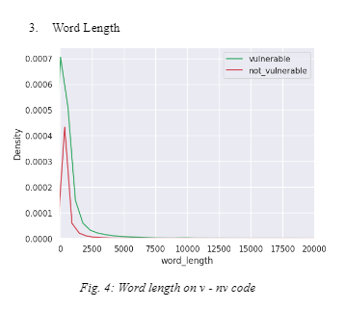
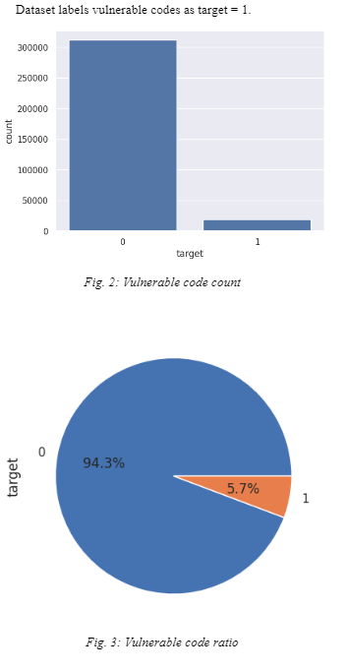
VULNERABLE AND NOT VULNERABLE RATIO
WORD LENGTH

Slide 9
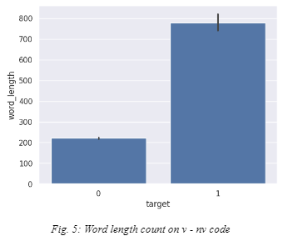
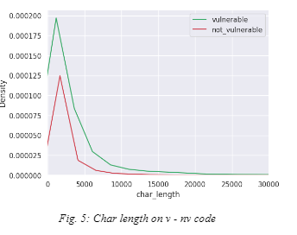
WORD LENGTH
CHAR LENGTH

Slide 10
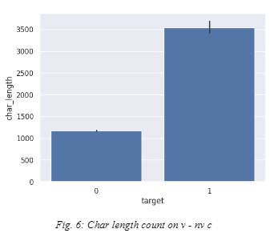
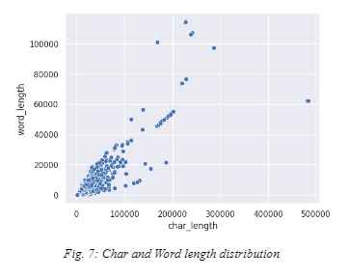
CHAR LENGTH
CHAR AND WORD LENGTH

Slide 11
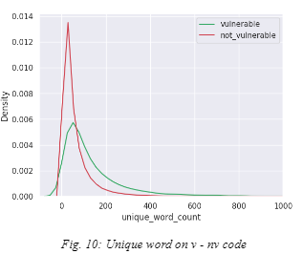
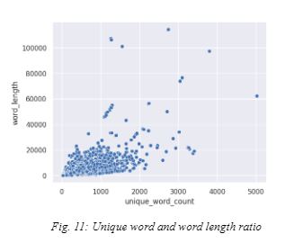
UNIQUE WORD
UNIQUE WORD

Slide 12
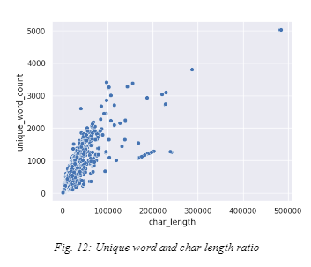
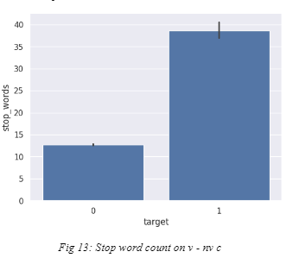
UNIQUE WORD
STOP WORD

Slide 13
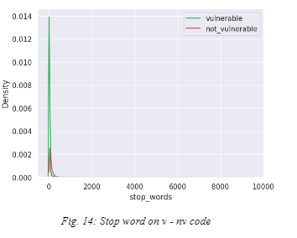
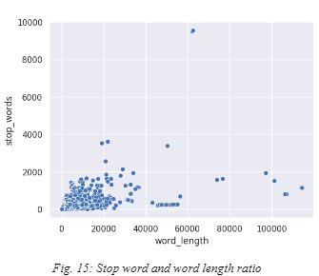
STOP WORD
STOP WORD

Slide 14
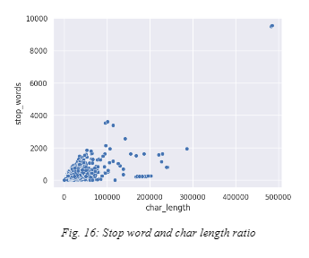
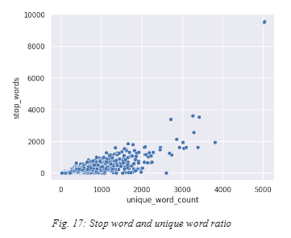
STOP WORD
STOP WORD

Slide 15

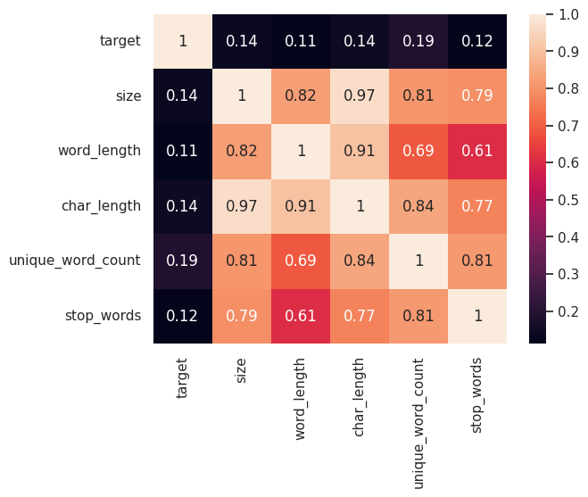
HEATMAP

Slide 16
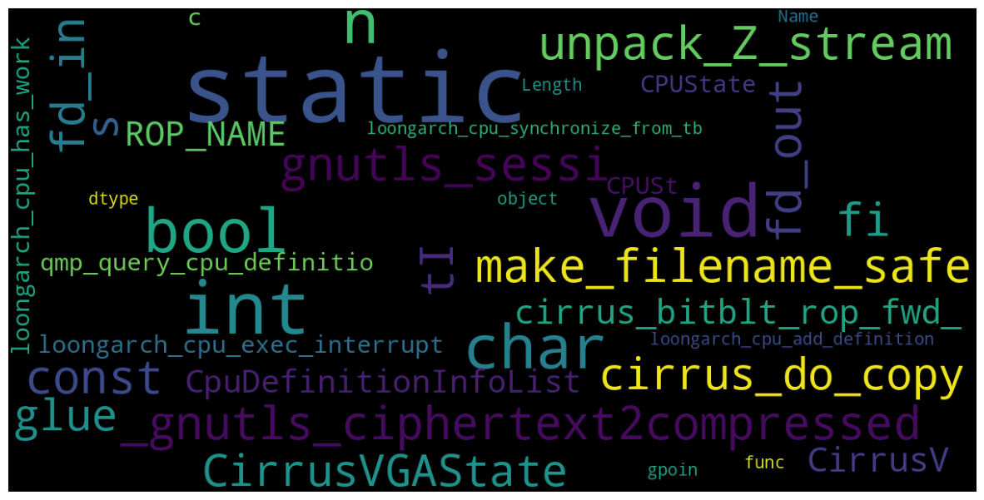
WORDCLOUD OF DATASET

Slide 17
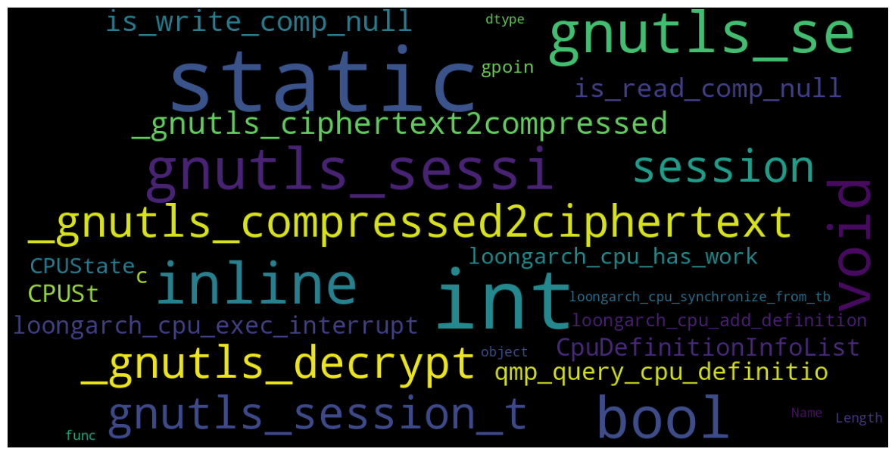
WORDCLOUD OF NOT VULN

Slide 18
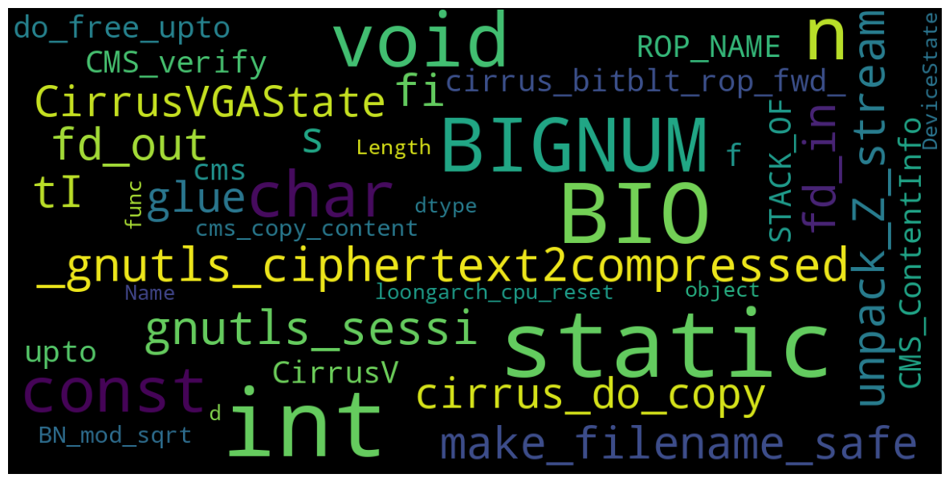
WORDCLOUD OF VULN

Slide 19

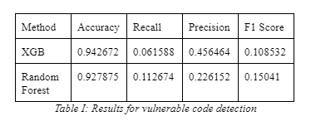
MODELS
After I characterize the dataset, I approach the problem as a normal NLP problem. I tried to find whether a given line of code is vulnerable or not. I used xgboost and random forest. Results are in Table I.

Slide 20


DISCUSSION
Although LLM models are popular nowadays, in the vulnerable code detection problem, there can be other optimal solutions. Machine learning algorithms such as XGB and Random Forest can be cheaper than big LLM and NLP models. If LLM and NLP based solutions are the same as Machine learning algorithm based solutions, ML based approaches will have less training cost such as time, memory, and process power.

Slide 21

DYNAMIC SCRAPED DATA
Although this paper uses only DiverseVul data, as a future work, real life data from other vulnerable code datasets can be used. Real life feed from code repositories (such as github) can be integrated into this kind of solution.
MORE PROGRAMMING
LANGUAGES
Characterization of the dataset can be covered in a more deep-dive approach. There are patterns and functions in every programming language respectively in Static Code Analysis (OWASP), these patterns and functions can be implemented as stop words etc. However, since this paper approaches the dataset as a NLP problem, I used standard English stop words
FUTURE
NLP/LLM BASED APPROACHES
WORK
For a comparative analysis between Machine Learning and LLM based solutions, more detailed research can be conducted. Although the reference paper, DiverseVul: A New Vulnerable Source Code Dataset for Deep Learning Based Vulnerability Detection, is a relatively-new study, new LLM systems such as Google Gemini can be fed with this dataset.
DIRECTION
STOPWORD OPTIMIZATON
VULNERABLE FUNCITONS AND PATTERNS FROM DATASET

Slide 22
CONCLUSION
In conclusion, this paper tries to understand the DiverseVul dataset by characterization of the DiverseVul dataset. Then, it uses several machine learning solutions on the dataset.
Although this kind of NLP problems are relatively-easy to solve in modern life LLM libraries, this paper suggests Machine Learning based approaches in order to decrease resource consumption.
In summary, this research characterizes and visualizes the DiverseVul dataset, and proposes some classification methods for vulnerable code detection. Although more deep-dive approaches can be done in this area, this paper focuses on simple and efficient machine-learning based solutions.

Slide 23
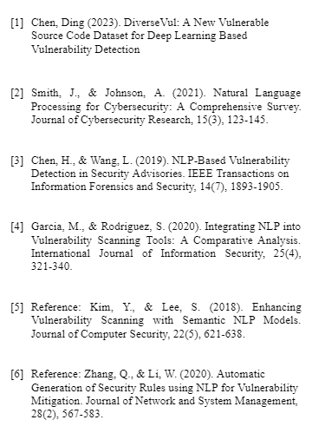
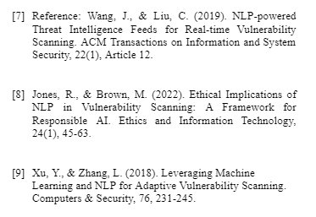
REFERENCES

Slide 24


THANK YOU

